Slide 1
Week-14: Gladiators
Team Members: Shivani Asokumar, Akash Narang, Mit Jain, Juhi Malkani
Team Lead: Juhi Malkani

Slide 2

Project: E-commerce Website for Footwear

Slide 3
Team Progress Update
New: Static Login page
New: Checkout page
New: filter by brands
Shopping Cart feature
Frontend
New: Auth module
Seller Page API
Individual Product Page, Shopping Cart APIs
New: Website can be hosted
Backend

Slide 4
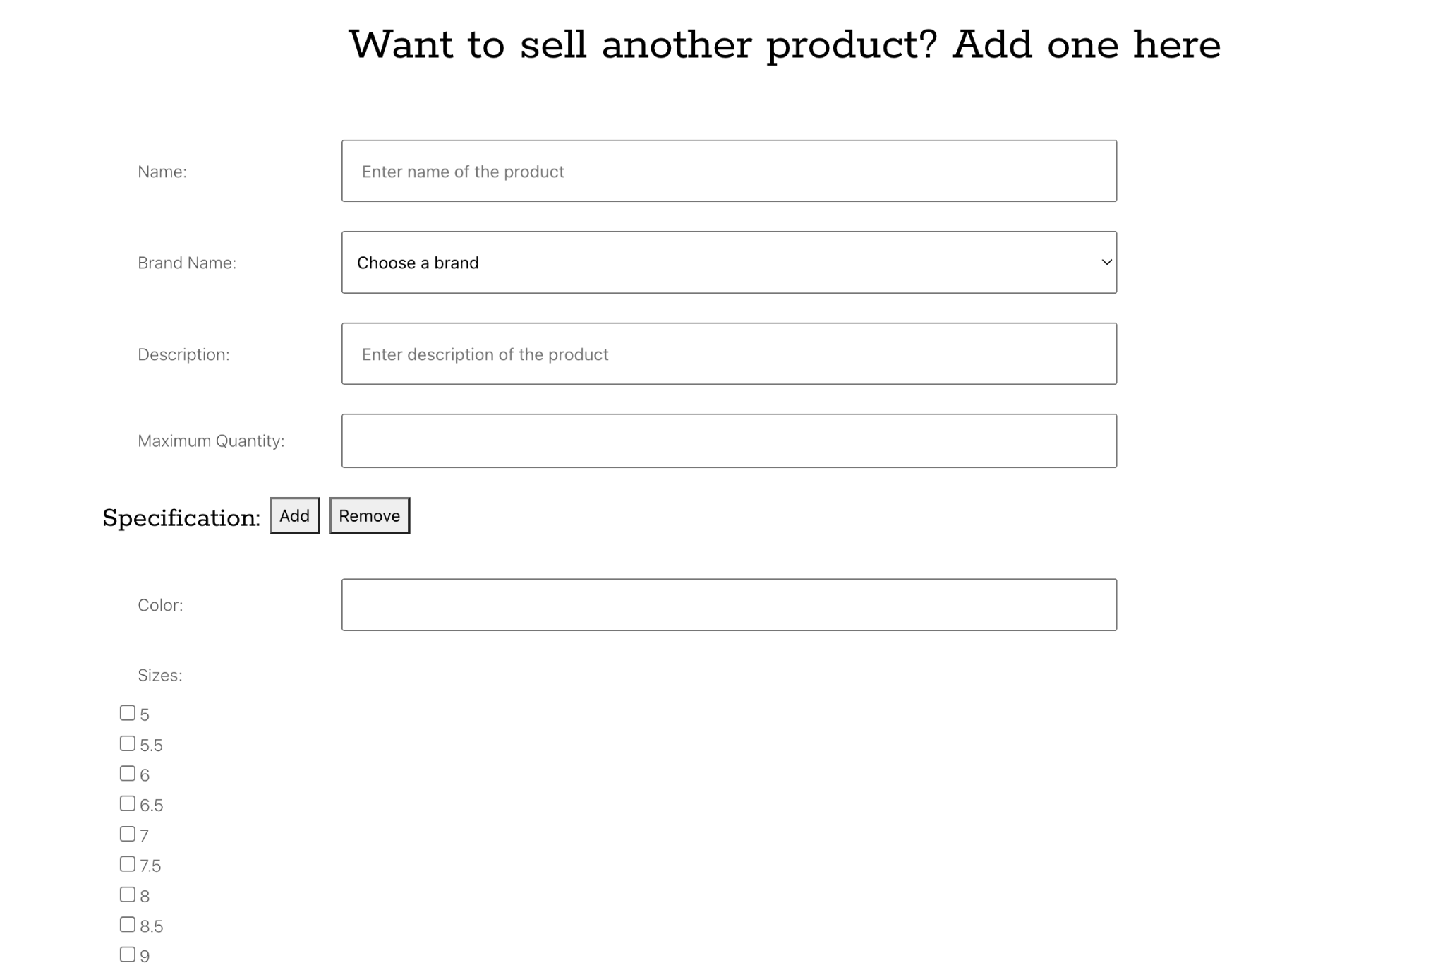
Seller Page (Completed)

Slide 5
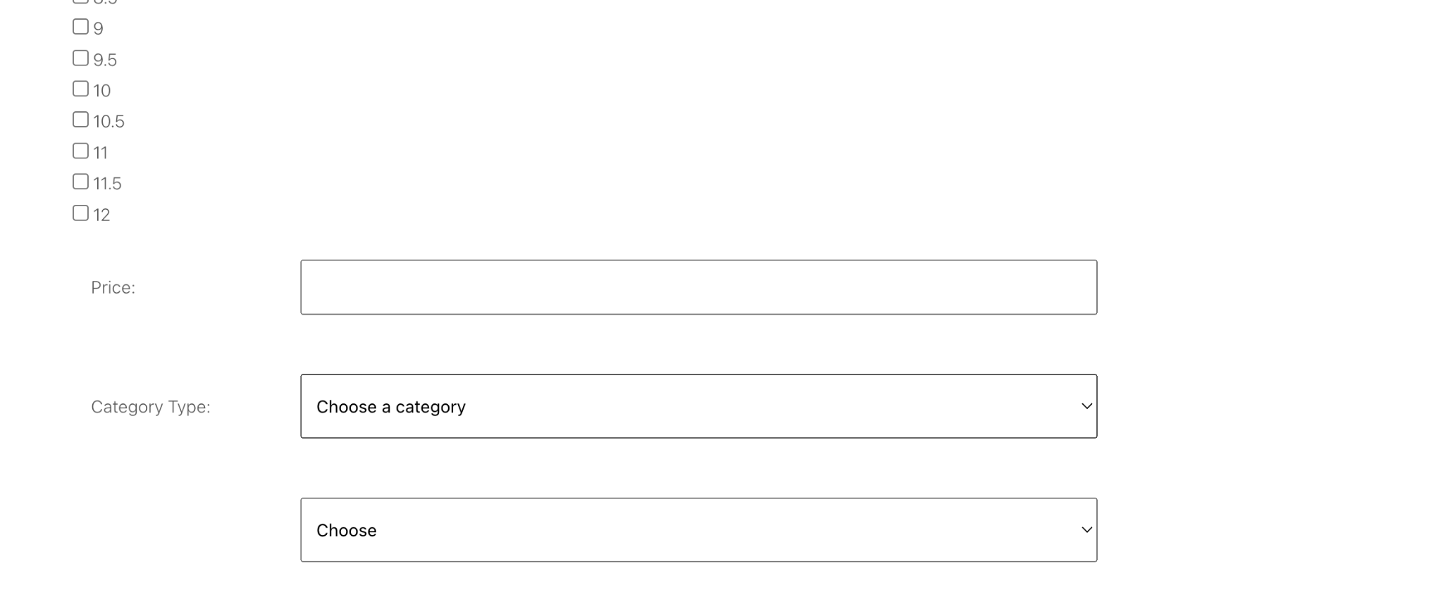
Seller Page (Completed)

Slide 6
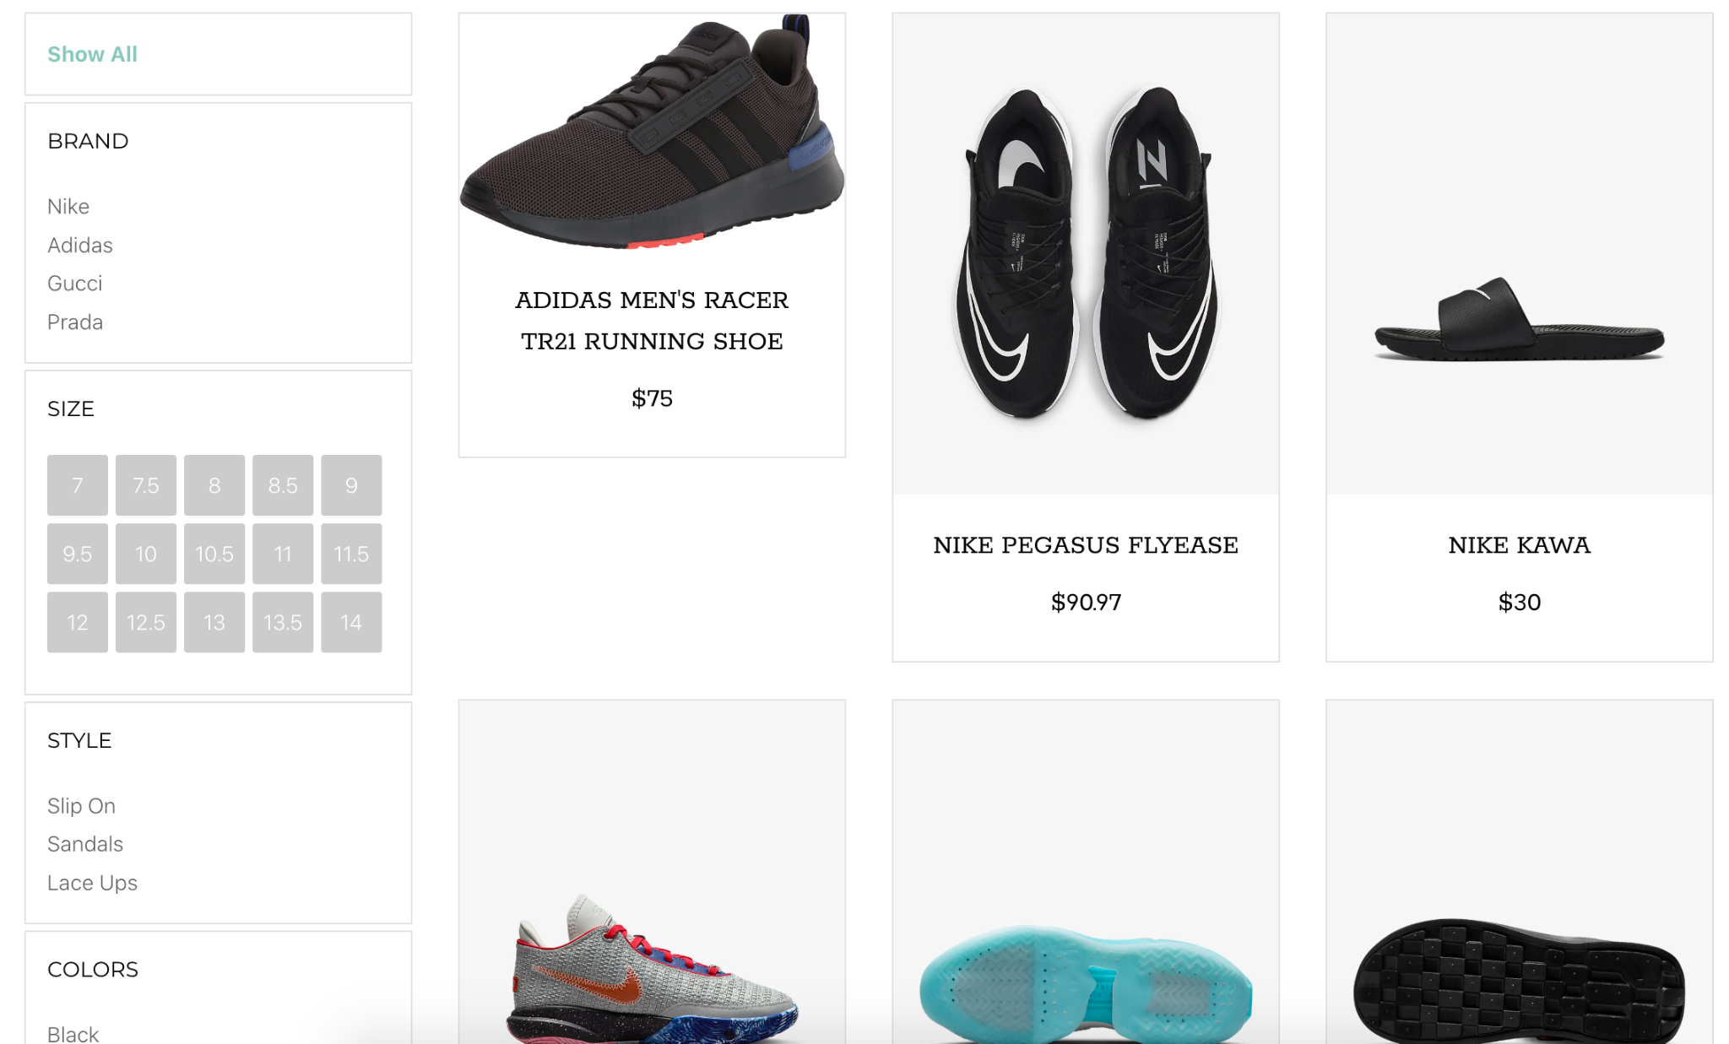
Product Listing

Slide 7
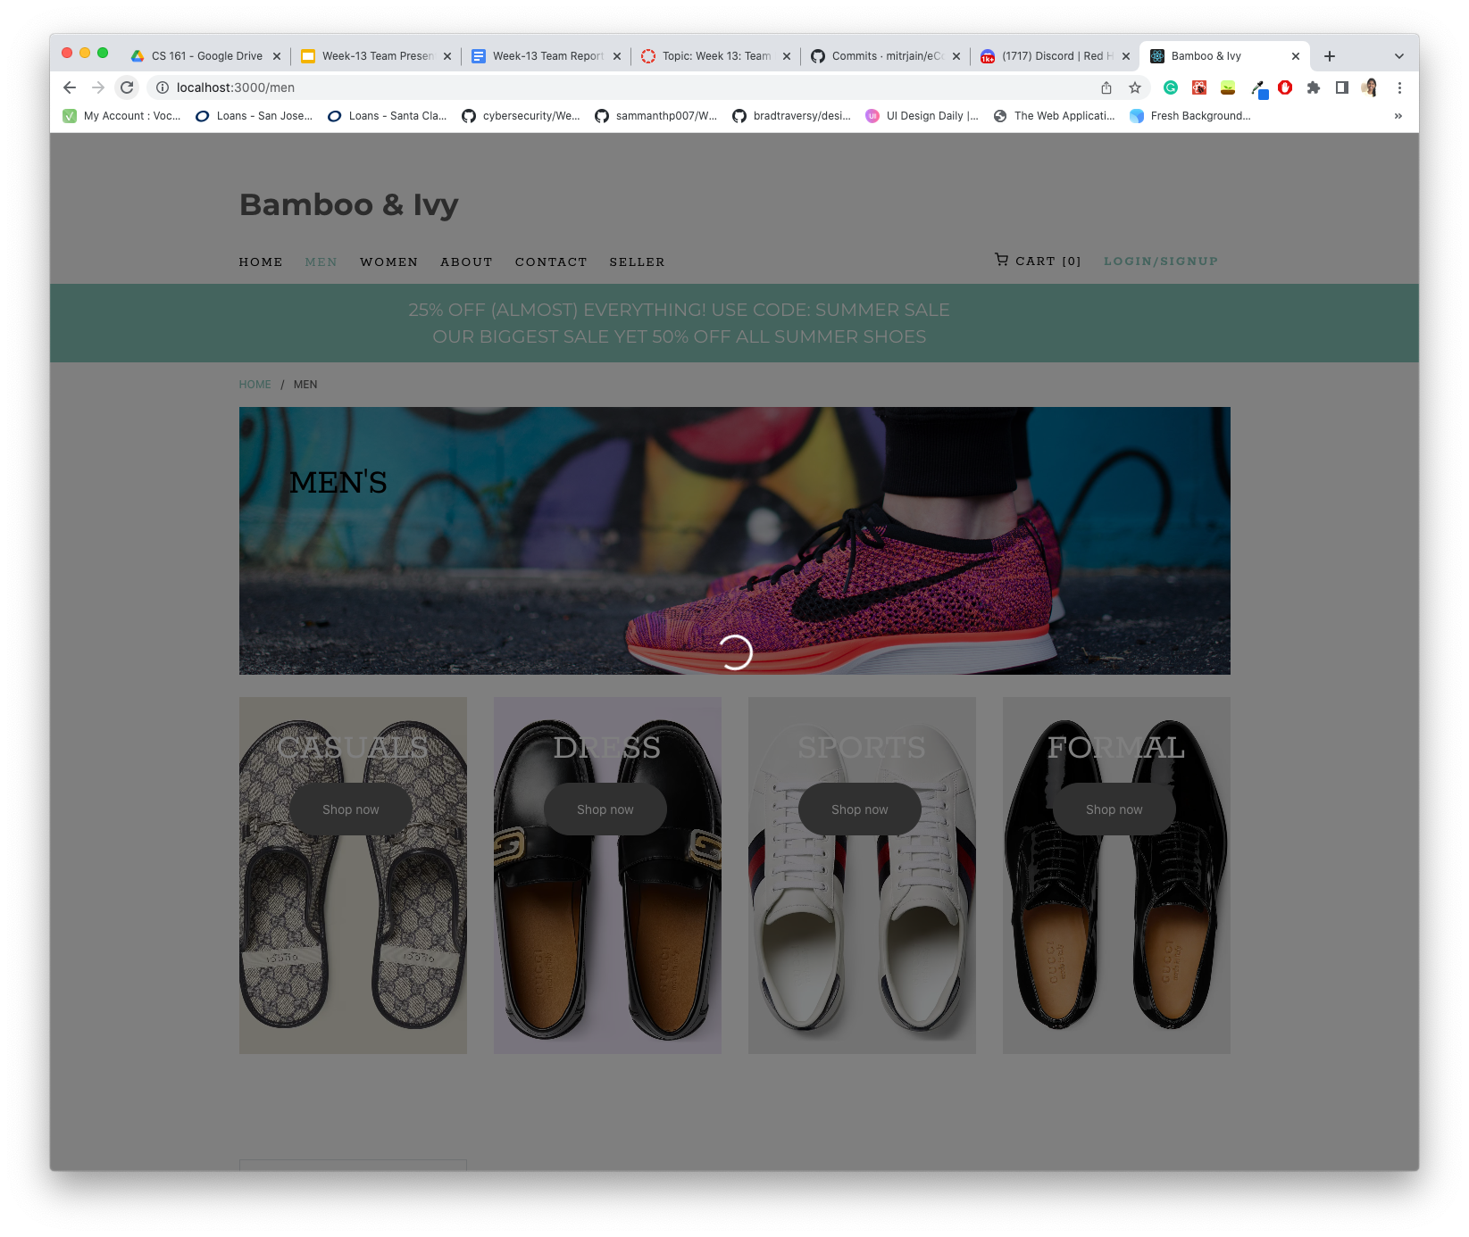
Loading Icon

Slide 8
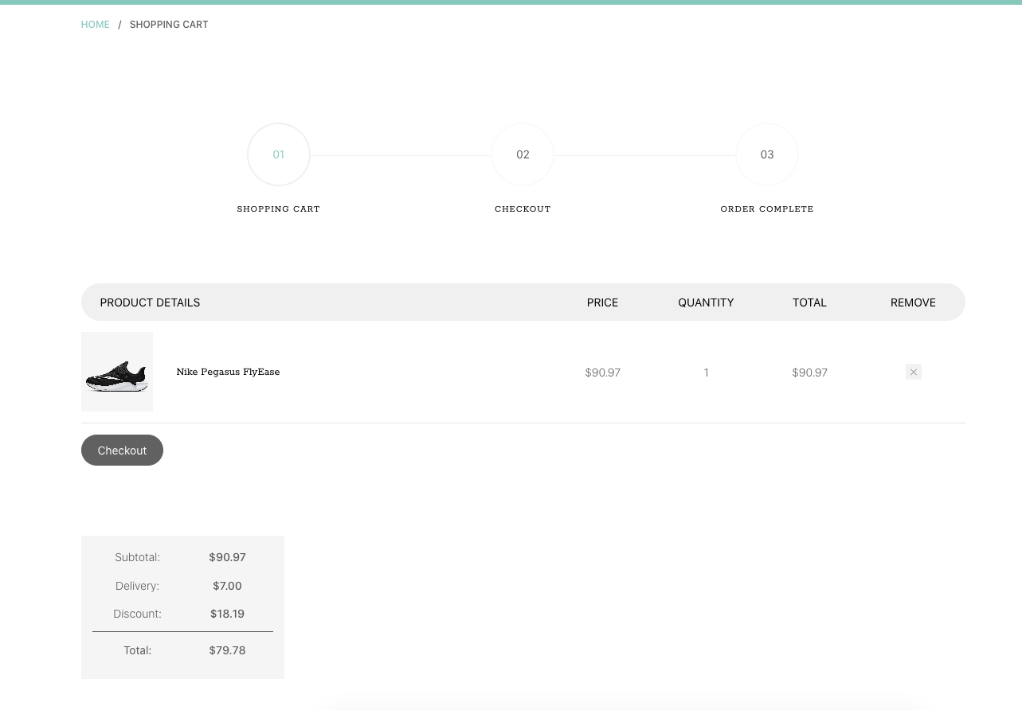
Shopping Cart

Slide 9
Hosting Methods
AWS EC2: For frontend application and backend server
AWS S3: For storing product images
MongoDB Atlas: For hosting Mongo DB
Product is hosted and can be demoed online

Slide 10
Milestones
M1
Seller Page
M2
Shopping Cart
M3
Men/Women
Best Sellers
M4
User Auth
Order Summary
M5
Checkout/Payment

Slide 11
Feedback (TreeHouse)
UI is pretty, but some buttons are not working as intended (e.g. next page button)
would appreciate an error message for the user if the backend server is down

Slide 12
Feedback Response
Next page button has been removed as we don’t have enough products for another page
Backend error message is future scope. Not sure if we have time to implement.

Slide 13
Thanks!

